Slide 1

The Battle of the Neighborhoods
Author: Mark L Cichonski
IBM Data Science Capstone
1/26/2021

Slide 2
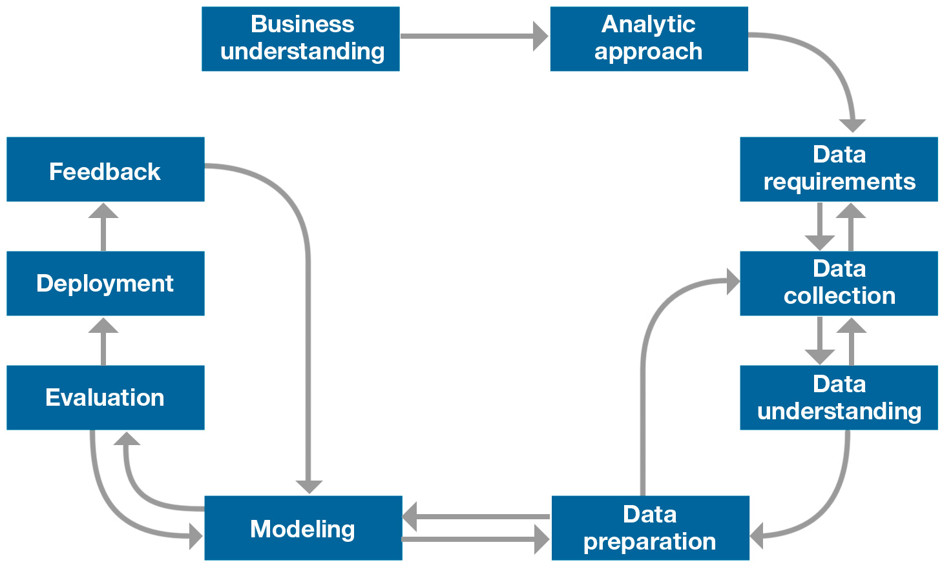
Roadmap

Slide 3

Abstract
This project is the capstone assignment for a 9 course IBM Professional Certificate in data science.
The scenario is that you live on the West side of the City of Toronto in Canada. You love your neighborhood mainly because of all the great amenities and other types of venues that exist in the neighborhood. Such as gourmet fast food joints, pharmacies, parks, grad schools, and so on. Now say you receive a job offer from a great company on the other side of the city with great career prospects. However, given the far distance from your current place, you unfortunately must move if you decide to accept the offer. Wouldn't it be great if you're able to determine neighborhoods on the other side of the city? There are exactly the same as your current neighborhood, and if not, perhaps similar neighborhoods that are at least closer to your new job.
In this capstone project, we had to be creative and come up with our own idea or problem to solve using location data. I chose the scenario where my company is looking for office space and will use location data to do so. Hence the name of the capstone project will be the battle of the neighborhoods.
Given my city of Charlotte, I will segment it into different neighborhoods using the geographical coordinates of the center of each neighborhood. And then, using a combination of location data and machine learning, I will group the neighborhoods into clusters and choose the optimal location for our office!

Slide 4

Business Understanding
Seek clarification
You have the opportunity to be as creative as you want and come up with an idea to leverage Foursquare location data to explore or compare neighborhoods or cities of your choice or to come up with a problem that you can use the Foursquare location data to solve.
What problem are you trying to solve
My company is opening a new office and we are looking for the prime location.
Clearly defined question
What is the best location to open a consulting business in Charlotte North Carolina?
What is the goal?
Find the prime location of an office for a consulting company.
Objectives in support of the goal. The criteria for selection will be:
Marketplace and demographics
Competition
Costs
Growth Potential
Safety
Recruiting
Brand Image
For this analysis, we will use FourSquare and additional data sources as needed to build the most comprehensive picture and select the best location for the office.

Slide 5

Analytic Approach
We will use location data and other data sources to build a picture of the Charlotte area and optimize our location based on the factors identified by the business as critical for the needs of a small business.
These factors will provide us with the location based on the availability of facilities, amenities, safety and the population makeup of any potential areas.
This will allow us to choose a location with the proper traffic and in accordance with the brand image we want the company to have.
To evaluate these factors we plan on using the information from FourSquare as primary data source, supported by other data as needed, to conduct segmenting and clustering of neighborhoods in Charlotte to determine the optimal location for our office.

Slide 6
Analytic Approach
 | Expected Analytical Approach
Factors | Descriptive | Diagnostic | Predictive | Prescriptive
Marketplace and demographics | X | X | X
Competition | X | X | X
Costs | X | X | X | X
Growth Potential | X | X | X
Safety | X | X | X
Recruiting | X | X | X | X
Brand Image | X | X | X | X
Descriptive-Current status, what is the current state?
Diagnostic-Why is the current state the way it is?
Predictive-What will happen in the area to determine future success?
Prescriptive-Where should we locate our office?

Slide 7
Data Requirements
 | Data Sources (Recipe) |  |  | Data Mining Technique
Factors | 4 Square | Additional Data | Additional Source
Marketplace and demographics | X | X | https://www.neighborhoodscout.com/nc/charlotte/demographics | Table-screen scrape
Competition | X | X | https://www.expertise.com/nc/charlotte/business-consultants#:~:text=Here%20are%20the%20Picks:%201%20Ballantyne%20Tax%20&,of%20consulting%20experience%20to%20business%20clients%20in%20Charlotte. | Table-screen scrape
Costs | X | X | https://www.crexi.com/properties?utm_term=%2Bcommercial%20%2Bestate%20%2Breal%20%2Bestate&utm_campaign=Bing_NonBrand_National_Sales&utm_source=bing&utm_medium=ppc&msclkid=b3dfd627eda714c838efb63e6cabe478 | Data-screen scrape
Growth Potential | X
Safety | X | X | https://www.neighborhoodscout.com/nc/charlotte/demographics | Table-screen scrape
Recruiting | X | X | http://blog.parkerlynch.com/jobs-report/charlotte-nc/ | Data-screen scrape
Brand Image | X

Slide 8
Data Collection
First step was to collect zipcodes:
Data source: Zip Codes to Go
Method: Pandas Read html
Link: ZIP Code List for North Carolina (zipcodestogo.com)
Need longitude and latitude by zipcode
Data source: opendatasoft
Method: Download and read CSV
Link: US Zip Code Latitude and Longitude — Opendatasoft
Foursquare for location analysis
Data source: Foursquare
Method: API/JSON
Link: Foursquare API
Crime data for factor analysis
Data source: Best Places
Method: Manual lookup on finalists.
Link: Zip 28205 (Charlotte, NC) Crime (bestplaces.net)
Commute time for factor analysis
Data Source: Best Places
Method: Manual lookup on finalists
Link: Zip 28205 (Charlotte, NC) Commuting (bestplaces.net)
Cost/Pricing
Data Source: Loop Net
Method: Search
Link: 28207 (Charlotte) Commercial Real Estate for Sale | LoopNet.com

Slide 9
Data Understanding
 | 1.Zips | 2. Location | 3. Foursquare | 4. Crime | 5. Commute | 6. Cost
Factors | X | X | X | X | X | X
Marketplace and demographics |  |  | X |  | X
Competition
Costs |  |  |  |  |  | X
Growth Potential |  |  | X | X
Safety |  |  |  | X
Recruiting
Brand Image |  |  | X
After looking at the available data, we decided that the amount of data available in the above 6 data sources was sufficient to make the location decision.
The zipcode data for North Carolina had over 1,000 records that had to be narrowed to the Charlotte area. This was then narrowed to the 74 zipcodes in the Charlotte area for analysis. The file with the lat/lon for the zipcodes was over 43,000 records that had to be merged with the 74 Charlotte areas zipcodes.
One challenge for this project was that the zipcode names did not exist and had to be looked up manually by map.

Slide 10
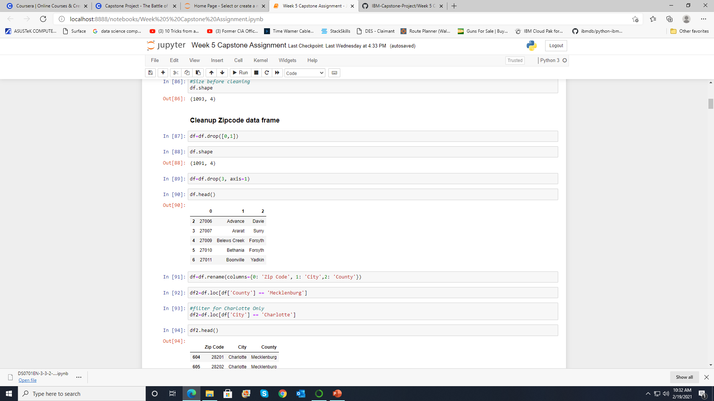
Data Preparation
Download zip code data in CSV.
Drop un-needed columns.
Rename columns for understanding.
Filter to a new dataframe for Charlotte only.
Download zip code lat/long information in CSV.
Convert code field to object type for merge with zip code data.
Merge files and drop un-needed columns.
Renamed columns of new dataframe.
Removed incorrect zip codes.
Change cluster labels to integers.
After cluster analysis, had to drop NAs for decision tree.
Create dummy variables for Y, location in decision tree analysis.

Slide 11
Modelling
Two models were developed for this analysis:
Kmeans Clustering. In the analysis, the average mean occurrence of each venue was calculated and stored in a data frame for the 41 neighborhoods. There were 137 venue types. The KMeans algorithm clusters data by trying to separate samples in n groups of equal variance, minimizing a criterion known as the inertia or within-cluster sum-of-squares. In this case, it is clustering the 41 neighborhoods based on the distance between venue occurrence means. I believe in this data set, there are so many 0 values, it is drastically affecting the results.
Decision Trees are a non-parametric supervised learning method used in this case for classification. The goal is to create a model that predicts the value of a target variable by learning simple decision rules inferred from the data features. A tree can be seen as a piecewise constant approximation. In this case the Y was the neighborhood and the X’s were the factors (narrowed down); food, hotel, bar, business services, violent crime, property crime and commute time. The decision tree looked first at violent crime and split the 5 samples with 4 <= 39.5. Then it looked at food establishments which we did not think was critical. We went left to the cost and the tree split even with properties less than $437500. We went back and looked at the 2 properties and chose the lowest cost, lowest crime and shortest commute, Eastover.

Slide 12
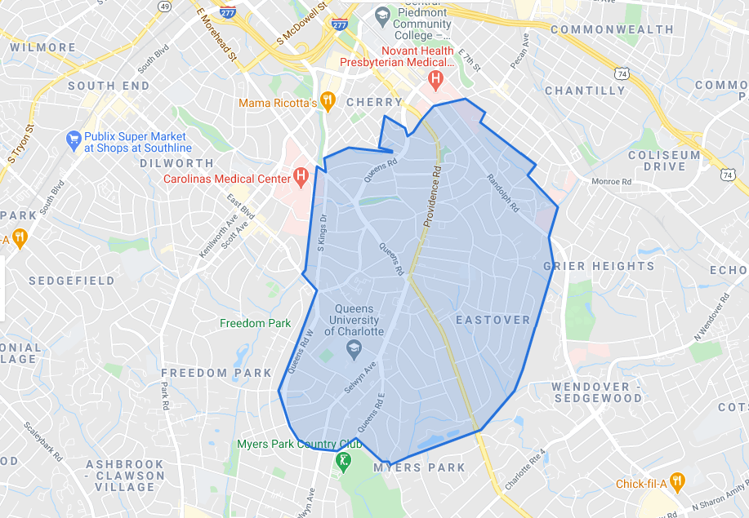
Conclusion
After clustering and decision tree classification, Eastover was selected as the optimal neighborhood.

